Slide 1



PEILab Group Meeting
Leader: Zicong Hong
Team Member: Jian Lin, Haodong Wang, Qianli Liu, Kaibin Guo, Junjie Liu

Slide 2

ResQ
ICML’25

Slide 3
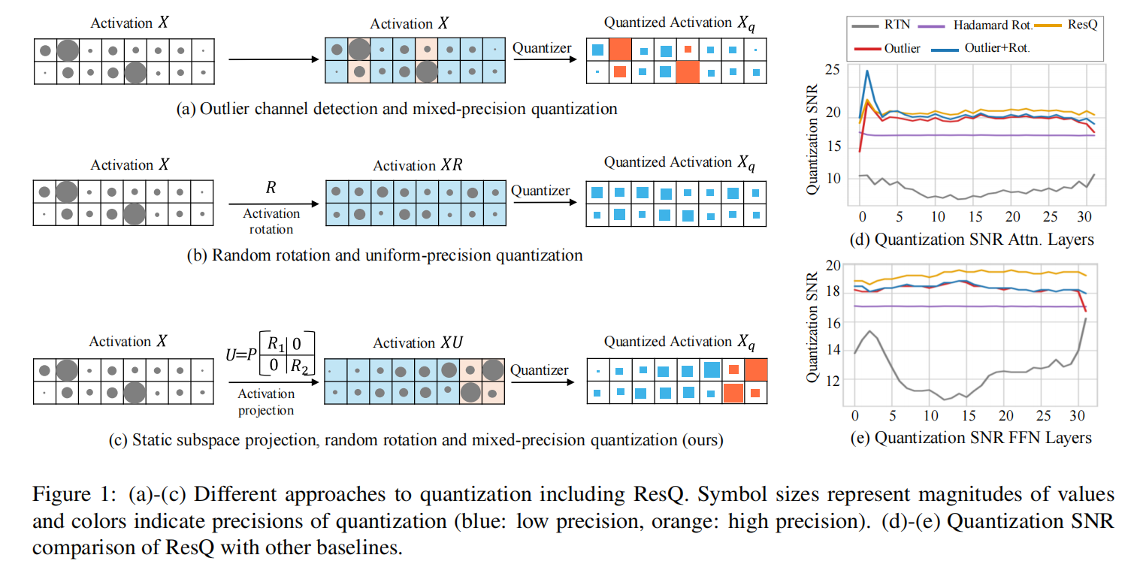
ResQ

Slide 4
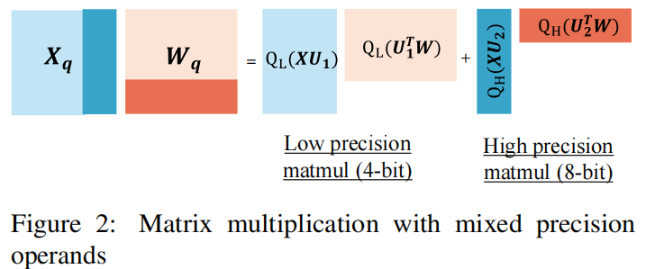
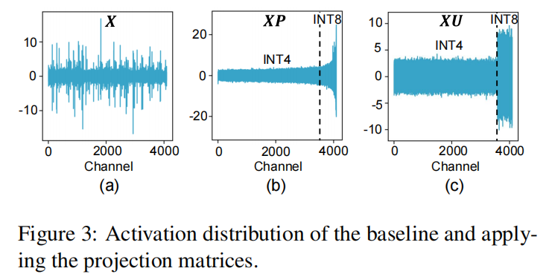
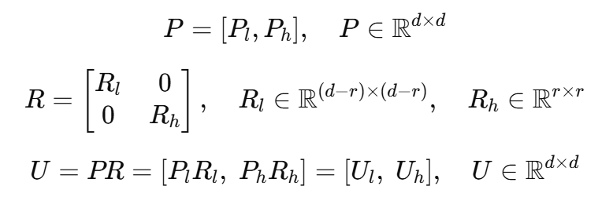

ResQ

Slide 5
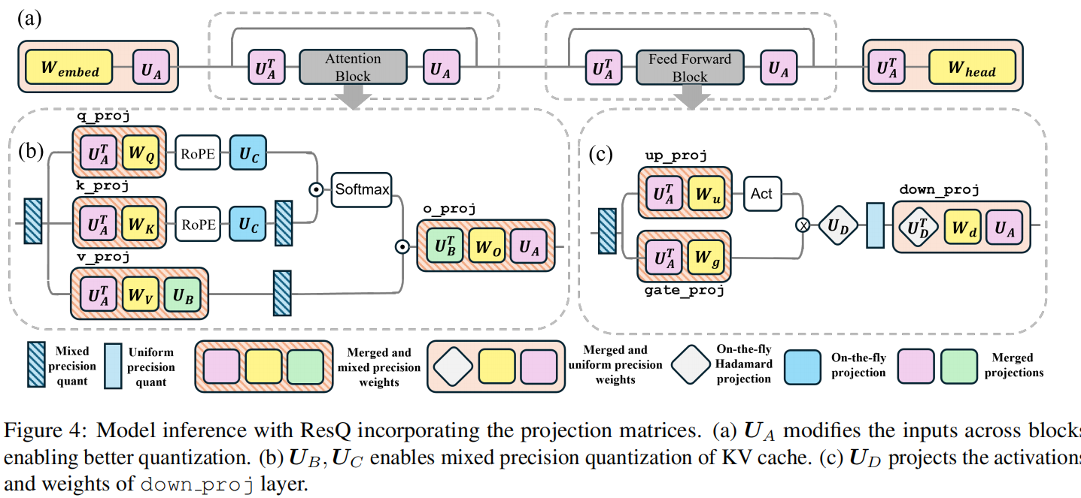
ResQ

Slide 6
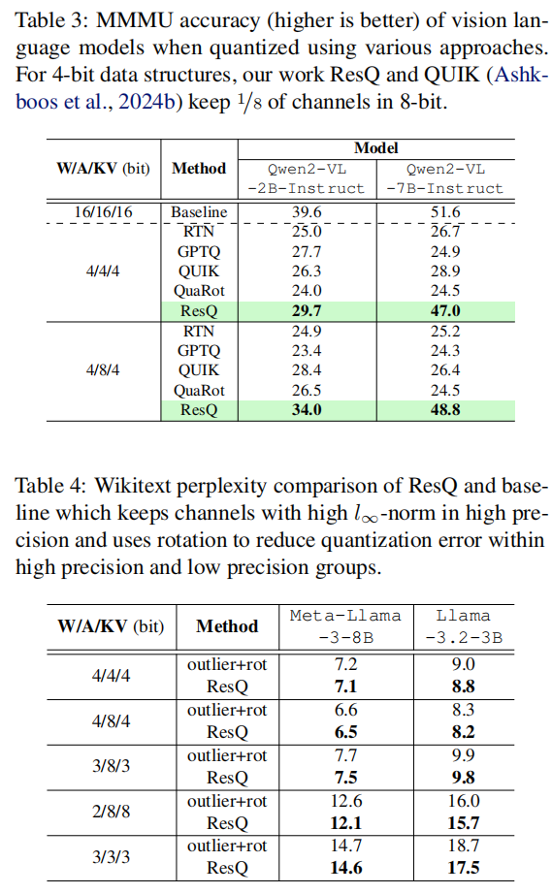
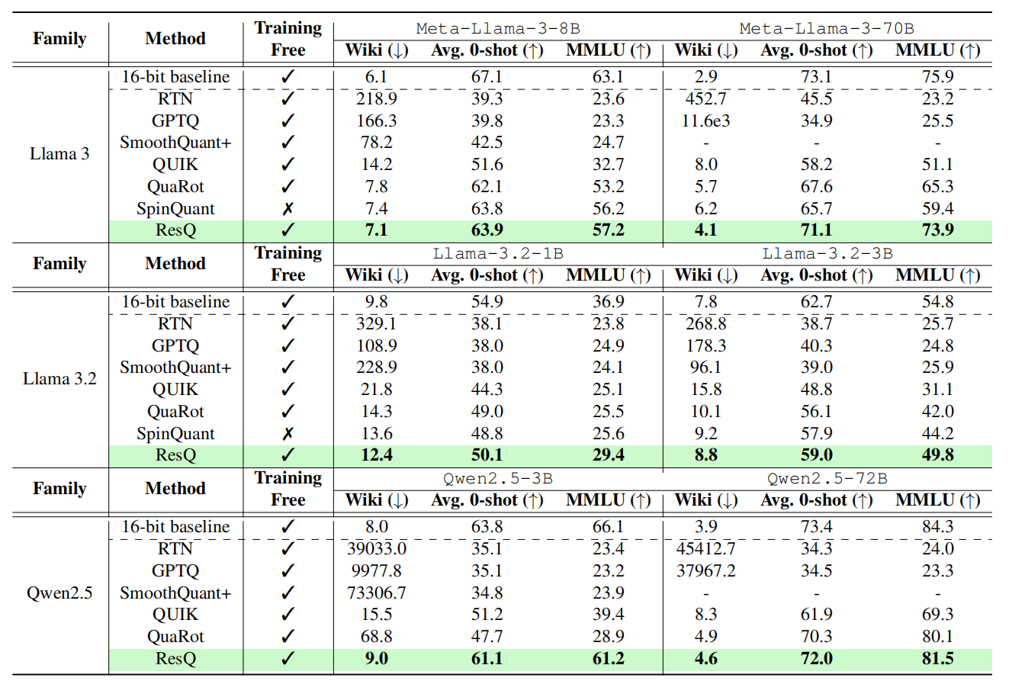
ResQ
Accuracy

Slide 7
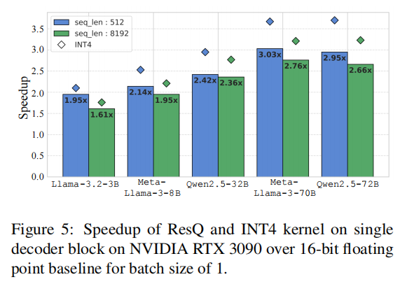
ResQ
Efficiency

Slide 8
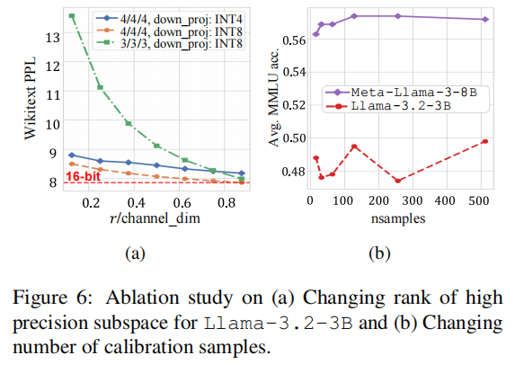
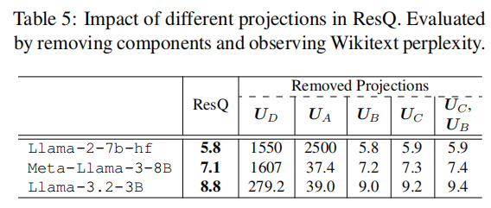
ResQ
Albation Study

